Slide 1
PHP File Handling
Lecture 15
& Other Security Precautions

Slide 2
Security Precautions
Whenever you are taking user input and using you need to be sure that the input is safe.
If you are going to insert the data into a MySQL database, then you should be sure you have thought about preventing MySQL Injection.
If you are going to make a user's input available to the public, then you should use PHP htmlentities.
htmlentities function prevents from running html code and scripts that may be harmful to your visitors.

Slide 3
Converting HTML into Entities
The htmlentities function takes a string and returns the same string with HTML converted into HTML entities.
For example, the string "<script>" would be converted to "&lt;script&gt;".
By converting the < and > into entities, it prevents the browser from using it as an HTML element and it prevents the code from running if you were to display some user's input on your website.
It will prevent your site from a lot of common attacks

Slide 4
Example 1
$userInput = "I am going to take your website !
<script type='text/javascript'>
window.location = 'http://www.example.com/' </script>'";
NOTE: this code, if written in input , will take u to some other page.
Preventing:
$userInputEntities = htmlentities($userInput);
echo $userInputEntities;

Slide 5
explode Function
PHP function explode lets you take a string and blow it up into smaller pieces.
For example, if you had a sentence you could ask explode to use the sentence's spaces " " as dynamite and it would blow up the sentence into separate words, which would be stored in an array.
The sentence "Hello, I would like to lose weight." would look like this after explode got done with it:
1. Hello,
2. I
3. would
4. like
5. to
6. lose
7. weight.

Slide 6
explode() Syntax:
explode("-", $rawPhoneNumber);
first argument that explode takes is the delimiter (our dynamite) which is used to blow up the second argument, the original string.
explode returns an array of string pieces from the original and they are numbered in order, starting from 0.

Slide 7
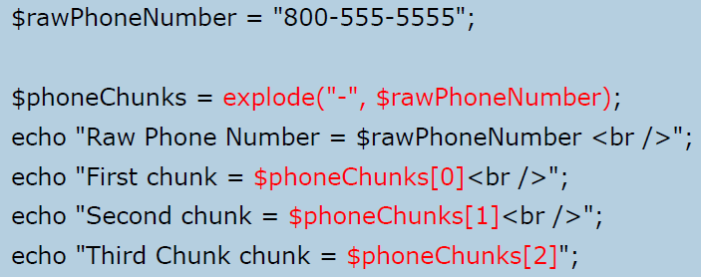
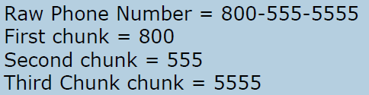
Example 2
Lets take a phone number in the form ###-###-#### and use a hyphen "-" as our dynamite to split the string into three separate chunks.
OUTPUT:

Slide 8
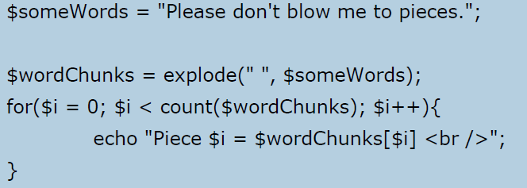
What is output of this code?
Notes:
Piece 0 = Please
Piece 1 = don't
Piece 2 = blow
Piece 3 = me
Piece 4 = to
Piece 5 = pieces.

Slide 9
PHP - Files
When you are manipulating files you must be very careful because you can do a lot of damage if you do something wrong.
PHP the fopen function is used to open files. However, it can also create a file if it does not find the file specified in the function call.
So if you use fopen on a file that does not exist, it will create it, given that you open the file for writing or appending.
fopen function needs two important pieces of information to operate correctly.
Name of the file that we want it to open.
Secondly, we must tell the function what we plan on doing with that file (i.e. read from the file, write information, etc).

Slide 10
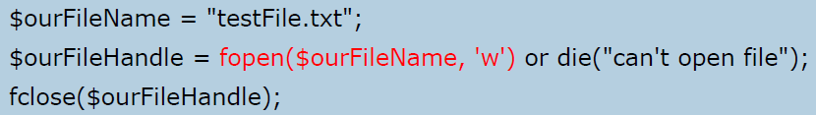
fopen() Syntax:
we inform PHP that we want to write by passing the character "w".
fopen function returns what is called a file handle, which will allow us to manipulate the file.
fclose takes the file handle that is to be closed

Slide 11
Types of Modes
Read: 'r'
Open a file for read only use.
The file pointer begins at the front of the file.
Write: 'w'
Open a file for write only use. In addition, the data in the file is erased and you will begin writing data at the beginning of the file.
This is also called truncating a file.
The file pointer begins at the start of the file.
• Append: 'a'
Open a file for write only use.
However, the data in the file is preserved and you begin will writing data at the end of the file. The file pointer begins at the end of the file.

Slide 12
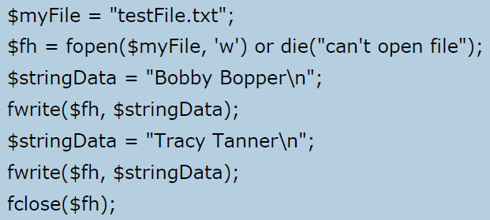
fwrite Function
fwrite function allows data to be written to any type of file.
fwrite's first parameter is the file handle and its second parameter is the string of data that is to be written.

Slide 13
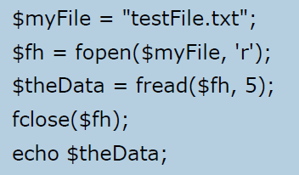


fread Function
fread function is the staple for getting data out of a file.
The function requires
a file handle, which we have, and
an integer to tell the function how much data, in bytes, it is supposed to read.
One character is equal to one byte. If you wanted to read the first five characters then you would use five as the integer.
testFile.txt contents
OUTPUT:

